Slide 1
ForestGEO plants
Made by Ian McGregor May 2019

Slide 2
Acer negundo

Slide 3
Acer platanoides

Slide 4
Acer rubrum

Slide 5
Ailanthus altissima

Slide 6
Amelanchier arborea

Slide 7
Asimina triloba

Slide 8
Berberis thunbergii

Slide 9
Carpinus caroliniana

Slide 10
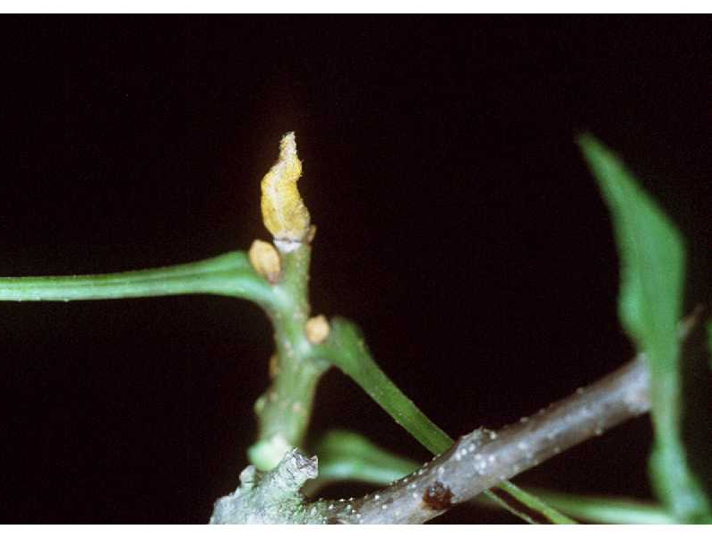
Carya cordiformis
Butternut hickory
5-11 leaflets
Sulfur (yellow) buds
Source: https://plants.usda.gov/core/profile?symbol=CACO15

Slide 11
Carya glabra
Pignut hickory
5 leaflets (rarely 7), entire
Glabrous (NOT hairy)
Hairless leafstalk and petiole
ONLY has green petioles
All Carya widest toward tip

Slide 12
Carya ovalis
Sweet pignut hickory
7 leaves (less often 5 or 9)
Petiolule green to red/brown at base
Often not hairy

Slide 13
Carya tomentosa
Mockernut hickory
7-9 leaflets, slightly serrated
Larger than C. glabra
Abaxial side is fuzzy
Leafstalk/petioles hairy also
Diamond interlace bark (esp. young)

Slide 14
Castanea dentata

Slide 15
Cercis canadensis

Slide 16
Celtis occidentalis

Slide 17
Chionanthus virginicus

Slide 18
Cornus alternifolia
Alternate-leaf dogwood
Looks exactly like C. florida EXCEPT multiple leaves come out of single point, which are arranged alternately along stems

Slide 19
Cornus florida
Dogwood
Leaves come out of same point 2 at a time, opposite to each other, and opposite on stem

Slide 20
Corylus americana
American hazelnut
Shrub
Leaves fuzzy, alternate
2+ leaves every node
Finely serrated, double-toothed
Prominent veins abaxial
Small lenticels on bark

Slide 21
Crataegus sp

Slide 22
Diospyros virginiana

Slide 23
Elaeagnus umbellata

Slide 24
Euonymus alatus

Slide 25
Fagus grandifolia

Slide 26
Fraxinus americana
White ash
Longest petioles of the three Fraxinus we have in plot
Very circular leaves
Whitened undersides
Slightly hairy
Rich purplish or reddish-brown fall color
http://www.uwgb.edu/biodiversity/herbarium/trees/fraxinus_comparison01.htm

Slide 27
Fraxinus nigra
Black ash
NO petioles (sessile)
More pinnate leaves than F. americana
No whitened underside
Mostly restricted to wetter sites
Mostly yellow fall color
http://www.uwgb.edu/biodiversity/herbarium/trees/fraxinus_comparison01.htm

Slide 28
Fraxinus pennsylvanica
Green ash
Barely has a petiole
Not really whitened underside
Mostly yellow fall color
http://www.uwgb.edu/biodiversity/herbarium/trees/fraxinus_comparison01.htm

Slide 29
Hamamelis virginiana

Slide 30
Ilex verticillata
Deciduous holly!

Slide 31
Juglans cinerea
Butternut
Fruit is longer than it is wide
Leaves are densely hairy underneath, hairs are branched (stellate)
Leafstalk has sticky hairs
Leaf scar has hair on top edge

Slide 32
Juglans nigra
Black walnut
Fruit is spherical
Leafstalk and petioles are short pubescent
Short hairs on undersides along vein ribs
Hairs are simple (not branched)

Slide 33
Juniperus virginiana

Slide 34
Lindera benzoin

Slide 35
Liriodendron tulipifera

Slide 36
Lonicera japonica

Slide 37
Lonicera mackii

Slide 38
Nyssa sylvatica
Leathery leaves

Slide 39
Paulownia tomentosa
Princess / Empress tree
Very fuzzy leaves
Also very large leaves
Heart-shaped

Slide 40
Pinus pungens

Slide 41
Pinus strobus

Slide 42
Pinus virginiana

Slide 43
Platanus occidentalis
American sycamore

Slide 44
Prunus avium

Slide 45
Prunus serotina

Slide 46
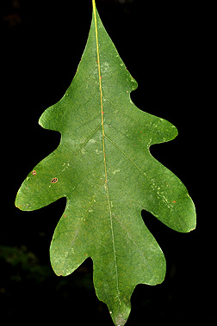
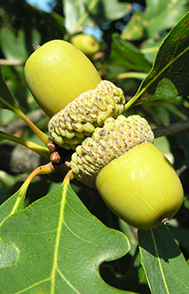
Quercus alba
White oak
Leaves have rounded lobes, no points
Bark is flaky-ish, very light in color
Source: http://dendro.cnre.vt.edu/dendrology/syllabus/factsheet.cfm?ID=35

Slide 47
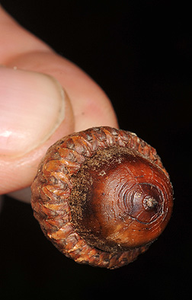
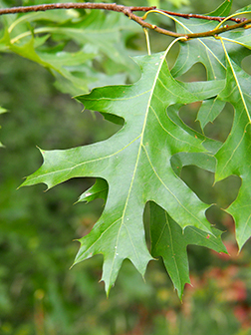
Quercus coccinea
Scarlet oak
NOT IN PLOT, included for comparison
Deep acorn cup
Buds have whitish hairy tip
Leaves most closely resemble Q. palustris
Main difference is extra lobes at tops
Small tufts white hair where veins meet midvein
Source: http://dendro.cnre.vt.edu/dendrology/syllabus/factsheet.cfm?ID=37

Slide 48
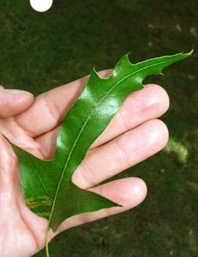
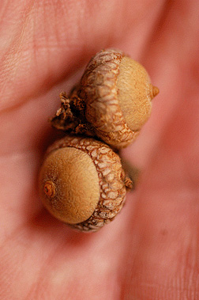
Quercus falcata
Southern red oak
NOT IN PLOT, included for comparison
Uneven lobes
Very hairy abaxially (undersides)
Like white hairy
Spines at lobe tips like other oaks
Source: http://dendro.cnre.vt.edu/dendrology/syllabus/factsheet.cfm?ID=68

Slide 49
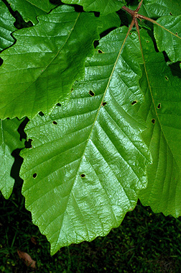
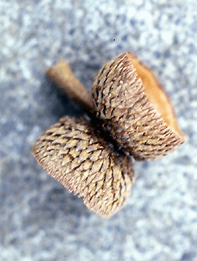
Quercus michauxii
Swamp chestnut oak
Was the same species as Q. prinus but then split based on range
Leaves are very similar to Q. prinus
Main difference is Q. michauxii generally has fuzzy leaf undersides
Source: http://dendro.cnre.vt.edu/dendrology/syllabus/factsheet.cfm?ID=243

Slide 50
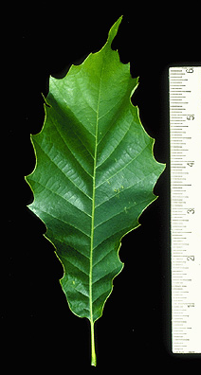
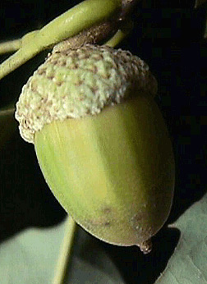
Quercus muehlenbergii
Chinkapin oak
NOT IN PLOT, included for comparison
Leaves also with scrapbook scissors, but a little more irregular and sharp tips
Green petioles, slight hairs
Small hairs abaxial
Small leaves compared to our other oaks
Source: http://dendro.cnre.vt.edu/dendrology/syllabus/factsheet.cfm?ID=244

Slide 51
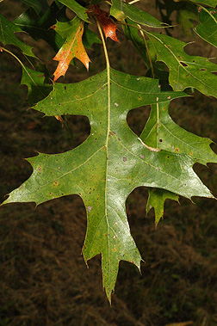
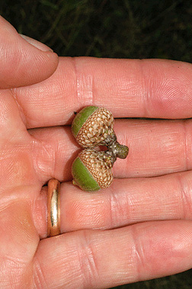
Quercus palustris
Pin oak
NOT IN PLOT, included for comparison
NOT hairy
Lobes are more rounded than Q. falcata and almost touch midvein
Drooping leaves, hair at midvien
Not as many tip lobes as Q. coccinea
Shallow acorn caps
Source: http://dendro.cnre.vt.edu/dendrology/syllabus/factsheet.cfm?ID=74

Slide 52
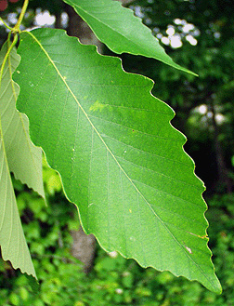
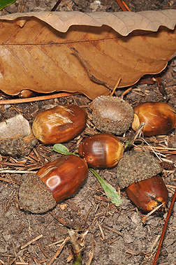
Quercus prinus (=Q. montana)
Chestnut oak
More common at SCBI than Q. michauxii (because this is the range of it)
Leaves look like used scrapbook scissors
Source: http://dendro.cnre.vt.edu/dendrology/syllabus/factsheet.cfm?ID=76

Slide 53
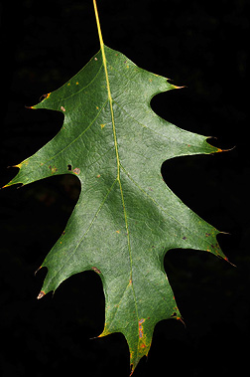
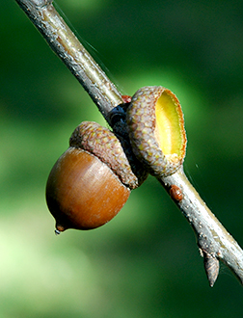
Quercus rubra
Northern red oak
Shallow acorn caps
Bark is reddish inside with shallow fissures
Hairless buds and hairless adult leaves
Alternate veins
Long and droop from twig tips
Leafstalk (petiole) green to red
Source: http://dendro.cnre.vt.edu/dendrology/syllabus/factsheet.cfm?ID=38

Slide 54
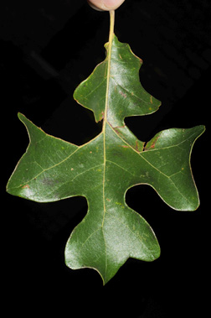
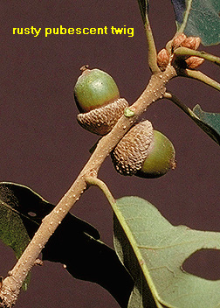
Quercus stellata
Post oak
NOT IN PLOT, included for comparison
Narrow lobes, rounded tips
Fat leaf area
“looks like drunk Q. alba”
Source: http://dendro.cnre.vt.edu/dendrology/syllabus/factsheet.cfm?ID=77

Slide 55
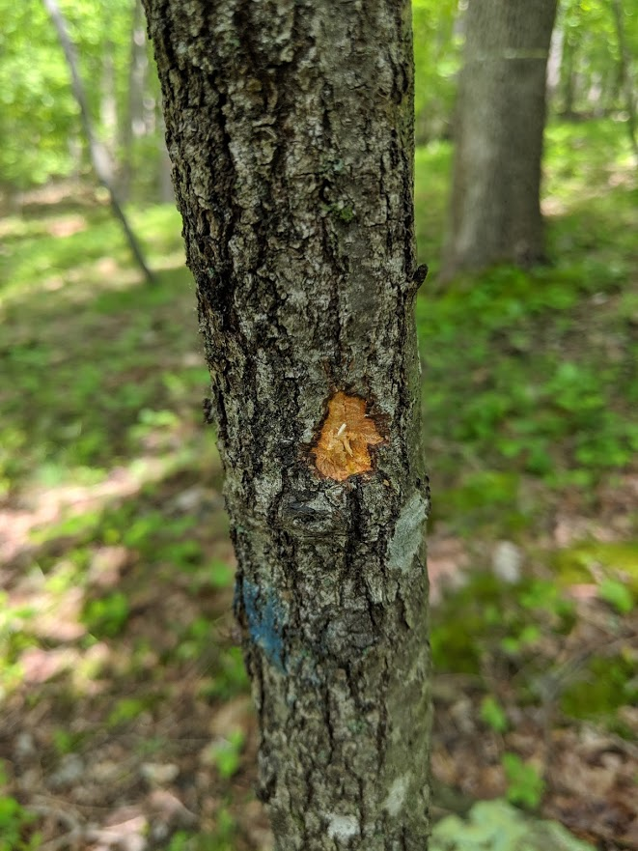
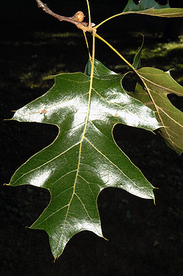
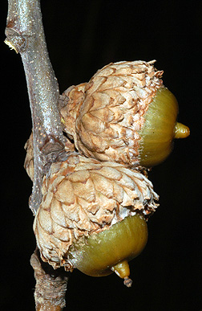
Quercus velutina
Black oak
Acorns have deep cup
Hairy adult leaves and hairy, green petioles
Sun leaves often smaller and have very deep lobes
Also drooping like Q. rubra
Easy to confuse with Q. rubra if can’t touch the leaves
Bark is irregular and blocky
Interior bark is yellow!
Source: http://dendro.cnre.vt.edu/dendrology/syllabus/factsheet.cfm?ID=39

Slide 56
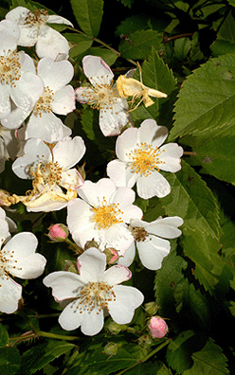
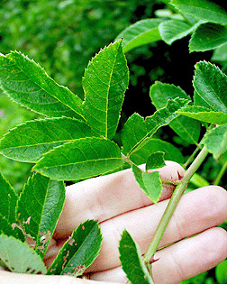
Rosa multiflora
INVASIVE
Can grow to dense thickets
White flowers with yellow center
Alternate, pinnately compound
Thorns curve up like scythe, will hook on to clothing and skin
5-11 serrated leaflets
Source: http://dendro.cnre.vt.edu/dendrology/syllabus/factsheet.cfm?ID=151

Slide 57
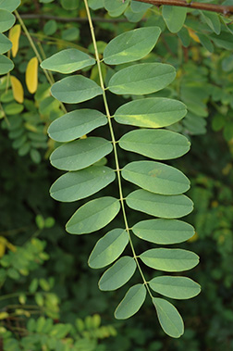
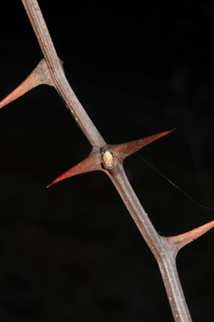
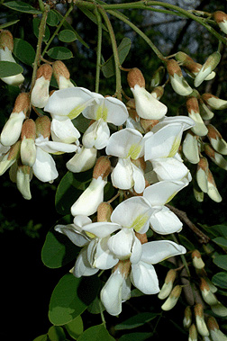
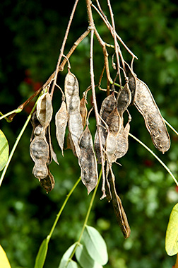
Robinia pseudoacacia
Black locust
Compound, alternate leaves
Entire, dull blue-green, 7-19 leaflets, each 1.5”
Fruit pods like flattened snap pea cases
Flowers small, pea-like (Fabaceae), hanging in 6” clusters
Thorns on stems and twigs, rugged bark
Much more outside the plot (along adjacent to Leach lake on road and on Leach road)
Source: http://dendro.cnre.vt.edu/dendrology/syllabus/factsheet.cfm?ID=40

Slide 58
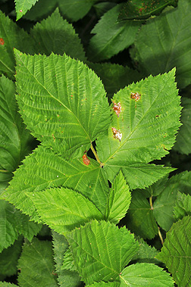
Rubus allegheniensis
Allegheny blackberry
NOT AS COMMON IN PLOT
5 leaves come out of central point
Tapered, serrated
Longer petioles
Alternate compound
Stalk can be large with large spines
Source: http://dendro.cnre.vt.edu/dendrology/syllabus/factsheet.cfm?ID=139

Slide 59
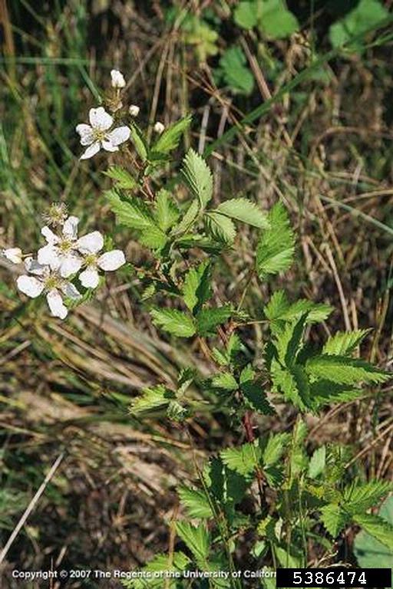
Rubus pensilvanicus
Pennsylvania blackberry
Alternate compound leaves
Terminal leaves the largest
3 leaves per leaflet
Coarse serration
Alternate veins
Source: https://www.invasive.org/browse/detail.cfm?imgnum=5386474

Slide 60
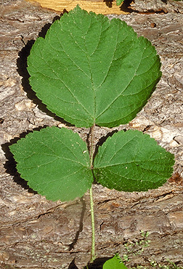
Rubus phoenicolasius
Wineberry, Wine raspberry
Small red raspberries
Leaves are very pale below
Thorns are red
Leaves arranged similar to R. pensilvanicus but larger
Very prickly-hairy stems
Stems are very red
Source: http://dendro.cnre.vt.edu/dendrology/syllabus/factsheet.cfm?ID=319

Slide 61
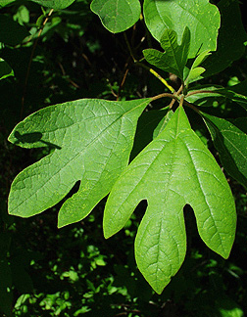
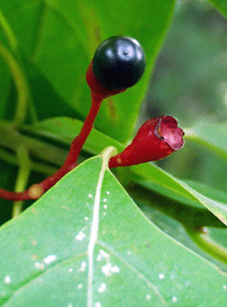
Sassafras albidum
Sassafras
Pale green undersides, fuzzy
Leaves are variably shaped (some like mittens)
Small dark berries from red stems
Small clustered flowers with new leaves in spring
Bark with deep furrows
Source: http://dendro.cnre.vt.edu/dendrology/syllabus/factsheet.cfm?ID=84

Slide 62
Sambucus canadensis

Slide 63
Tilia americana

Slide 64
Ulmus americana

Slide 65
Ulmus rubra

Slide 66
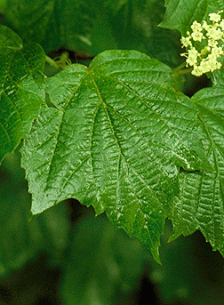
Viburnum acerifolium
Mapleleaf viburnum
Looks like small maple leaves but NO RED STEM
Opposite leaves and very fuzzy
We don’t have many of these tagged in the census, but there are many of these in the deer exclosure (esp the SW part) as small shrubs
Source: http://dendro.cnre.vt.edu/dendrology/syllabus/factsheet.cfm?ID=91

Slide 67
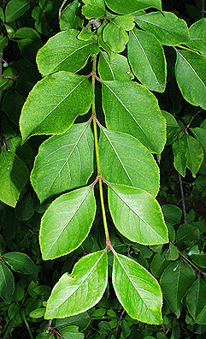
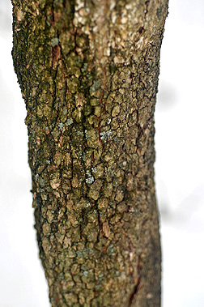
Viburnum prunifolium
Blackhaw
Large shrub or small tree
Bark looks like alligator hide
Look like cherry leaves
BUT are opposite (Prunus is not opposite)
Most common Viburnum in ForestGEO census
Source: http://dendro.cnre.vt.edu/dendrology/syllabus/factsheet.cfm?ID=129

Slide 68
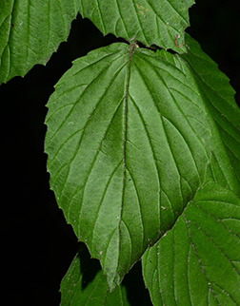
Viburnum recognitum (=V. dentatum)
Arrowwood
Very fuzzy leaves like V. acerifolium
Opposite
Basically it’s like you took V. acerifolium leaves and got rid of the lobes
Also not really in ForestGEO census, but definitely present in deer exclosure
Source: http://dendro.cnre.vt.edu/dendrology/syllabus/factsheet.cfm?ID=357

